Slide 1
Using JDBC with Spring +
Making Services Transactional + Spring iBATIS Integration

Slide 2
Agenda
Problems with Traditional JDBC– beans
Spring’s solution
Configuring DataSource
  Data sources that are looked up by JNDI
  Data sources that pool connections
  Data sources that are defined by a JDBC driver
JDBC Template
  Writing a WidgetDAO Implementation with the JdbcTemplate
    Implementing the getters
    Implementing the save
    Implementing the delete
Questions

Slide 3
Review the Assignment & Assessment
Performance Monitor

Slide 4
Spring Framework
Packages:
– beans
– context
– dao
– jdbc
– orm
– transaction
– jms
– web
– webmvc

Slide 5
Problems with Traditional JDBC
The exact same code appears in lots of places
You find yourself doing the same things over and over again
It’s redundant .The problem associated with redundancy is Maintenance Nightmare.

Slide 6
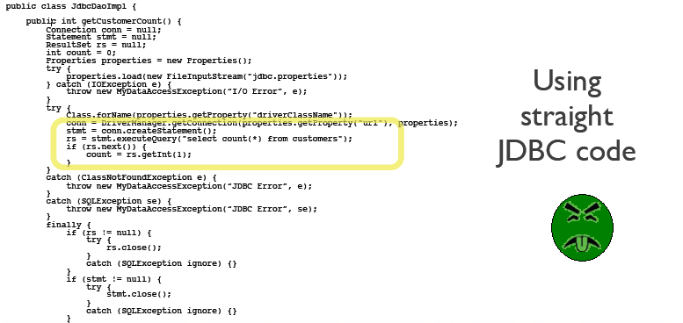
Yuck!!
Notes:
The data access templates are not all there is to Spring’s data access framework.Each template also provides convenience methods that simplify data access without
the need to create an explicit callback implementation.

Slide 7
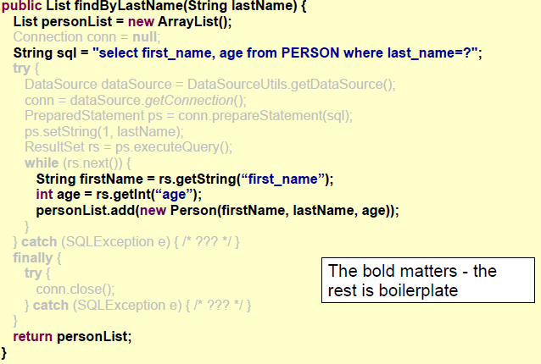
Redundant Error Prone Code
Notes:
The data access templates are not all there is to Spring’s data access framework.Each template also provides convenience methods that simplify data access without
the need to create an explicit callback implementation.

Slide 8
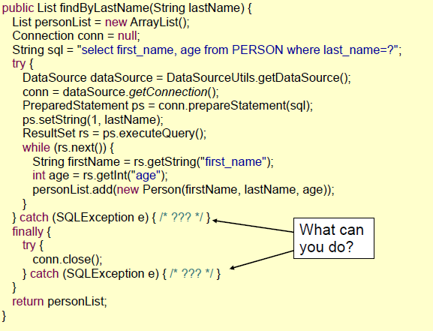
Poor Exception Handling
Notes:
The data access templates are not all there is to Spring’s data access framework.Each template also provides convenience methods that simplify data access without
the need to create an explicit callback implementation.

Slide 9
Spring’s solution – The Template Pattern
Template Pattern – “Define the skeleton of an algorithm in an operation, deferring some steps to subclasses. Template Method lets subclasses redefine certain steps of an algorithm without changing the algorithm's structure.”
Uses “callbacks” for implementation specific tasks
Notes:
The data access templates are not all there is to Spring’s data access framework.Each template also provides convenience methods that simplify data access without
the need to create an explicit callback implementation.

Slide 10
So what do this mean in a JDBC context?
DAO Template
DAO Callback
Prepare Resources
Start Transaction
Execute Statement
Commit/Rollback
Clean up resource
Handle exceptions
Return Data

Slide 11
But before we get too far ahead…
…let’s see how we
Obtain/create a DataSource
  Data sources that are looked up by JNDI
  Data sources that pool connections
  Data sources that are defined by a JDBC driver
Using JNDI data sources
    Spring’s JndiObjectFactoryBean makes it possible to retrieve any object, including data sources, from JNDI and make it available as a Spring bean
      <bean id="dataSource"
      class="org.springframework.jndi.JndiObjectFactoryBean"
      scope="singleton">
      <property name="jndiName" value="/jdbc/uhgDatasource" />
      <property name="resourceRef" value="true" />
      </bean>
Notes:
Spring applications will quite often be deployed to run within a JEE application server such as WebSphere, JBoss, or even a web container like Tomcat. These servers allow you to configure data sources to be retrieved via JNDI. The benefit of configuring data sources in this way is that they can be managed completely external to the application, leaving the application to simply ask for a data source when it’s ready to access the database.
if the application is running within a Java application server then you’ll want to set the resourceRef property to true. When resourceRef is true, the value of jndiName will be prepended with java:comp/env/ to retrieve the data source as a Java resource from the application server’s JNDI directory. Consequently, the actual name used will be java:comp/env/jdbc/
uhgDatasource.
JNDI data

Slide 12
Configuring DataSource ( contd)
Using a pooled DataSource
  Spring doesn’t provide a pooled data source, there’s a suitable one available in the Jakarta Commons Database Connection Pools (DBCP) project
      <bean id="dataSource"
      class="org.apache.commons.dbcp.BasicDataSource">
      <property name="driverClassName" value="org.hsqldb.jdbcDriver" />
      <property name="url"
      value="jdbc:hsqldb:hsql://localhost/uhg/uhgDataSource" />
      <property name="username" value="sa" />
      <property name="password" value="" />
      <property name="initialSize" value="5" />
      <property name="maxActive" value="10" />
      </bean>
Notes:
Pool-configuration property What it specifies
initialSize The number of connections created when the pool is started.
maxActive The maximum number of connections that can be allocated from the pool at the same time. If zero, there is no limit.
maxIdle The maximum number of connections that can be idle in the pool without extras being released. If zero, there is no limit.
maxOpenPreparedStatements The maximum number of prepared statements that can be allocated from the statement pool at the same time. If zero, there is no limit.
maxWait How long the pool will wait for a connection to be returned to the pool (when there are no available connections) before an exception is thrown. If –1, wait indefinitely.
minEvictableIdleTimeMillis How long a connection can remain idle in the pool before it is eligible for eviction.
minIdle The minimum number of connections that can remain idle in the pool without new connections being created.
poolPreparedStatements Whether or not to pool prepared statements (boolean).

Slide 13
Configuring DataSource ( contd)
Using a JDBC driver
  Simplest data source you can configure in Spring is one that is defined through a JDBC driver
    DriverManagerDataSource :Returns a new connection every time that a connection is requested.
    SingleConnectionDataSource—Returns the same connection every time that a connection is requested.
      <bean id="dataSource"
      class="org.springframework.jdbc.datasource.
      DriverManagerDataSource">
      <property name="driverClassName"
      value="org.hsqldb.jdbcDriver" />
      <property name="url"
      value="jdbc:hsqldb:hsql://localhost/uhg/uhgDataSource" />
      <property name="username" value="sa" />
      <property name="password" value="" />
      </bean>
Notes:
Although SingleConnectionDataSource and DriverManagerDataSource are great for small applications and running in development, you should seriously consider the implications of using either in a production application. Because SingleConnectionDataSource has one and only one database connection to work with, it doesn’t work well in a multithreaded application. At the same time, even though DriverManagerDataSource is capable of supporting multiple threads, it incurs a performance cost for creating a new connection each time a
connection is requested. Because of these limitations, I strongly recommend using pooled data sources.

Slide 14
JDBC Template
JdbcTemplate simplifies the use of JDBC and helps to avoid common errors.
  It executes core JDBC workflow, leaving application code to provide SQL and extract results.
  Executes SQL queries or updates, initiating iteration over ResultSets and catching JDBC exceptions and translating them to the generic, more informative exception hierarchy defined in the org.springframework.dao package.
Notes:
A JdbcTemplate can be used within a service implementation via direct instantiation with a DataSource reference, or get prepared in an application context and given to services as bean reference.

Slide 15
Writing a WidgetDAO Implementation with the JdbcTemplate (1)
Implementation of the WidgetDAO interface
/**
* DAO interface for Widgets
*/
public interface WidgetDAO
{
/**
* Returns a collection of all Widgets in the system.
*/
public Collection getWidgets();
/**
* Get a Widget Object given the id
*/
public Widget getWidgetById(Long id);
/**
* Creates a Widget Object,
*/
public void createWidget(Widget widget);
/**
* Save a Widget Object,
*/
public void updateWidget(Widget widget);
/**
* Deletes a Widget Object,
*/
public void deleteWidget (Long widgetId)
}

Slide 16
WidgetDAO JDBC implementation using Spring JdbcTemplate. (2)
/**
* WidgetDAO JDBC implementation using Spring JdbcTemplate.
*/
public class WidgetDAOJdbcImpl implements WidgetDAO
{
private DataSource dataSource;
private JdbcTemplate jdbcTemplate;
public void setDataSource(DataSource dataSource)
{
this.dataSource = dataSource;
jdbcTemplate = new JdbcTemplate(dataSource);
}
...
}

Slide 17
WidgetDAO JDBC implementation using Spring JdbcTemplate. (3)
We can easily wire this up in our application with something like:
  <bean id="dataSource"
  class="org.apache.commons.dbcp.BasicDataSource">
      <property name="driverClassName" value="org.hsqldb.jdbcDriver" />
      <property name="url" value="jdbc:hsqldb:hsql://localhost" />
      <property name="username" value="sa" />
      <property name="password" value="" />
  </bean>
  <bean id="widgetDao" class="com.uhg.jdbc.dao.impl.WidgetDAOMapImpl“>
  <property name="dataSource" ref="dataSource" />
  </bean>

Slide 18
Creating a Table
Our database table for Widgets looks something like this:
CREATE TABLE WIDGETS
(
  WIDGET_ID INTEGER GENERATED BY DEFAULT AS IDENTITY(START WITH 1) NOT NULL ,
  NAME varchar(255),
  SIZE int
);

Slide 19
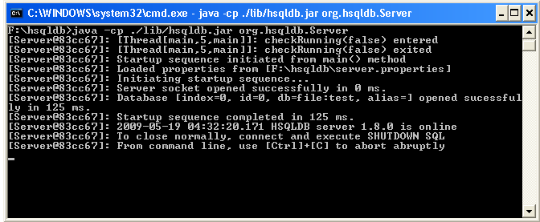
Setting up the Database (1)
To run the example, first start the HSQLDB server. To start the HSQLDB server, run the command prompt, go to the hsqldb directory and execute the following command.
java -cp <Path to jar>/hsqldb.jar org.hsqldb.Server
Open a new command prompt, go to the hsqldb installed
directory and type the following command.
java -cp <Path to jar>/hsqldb.jar org.hsqldb.util.DatabaseManager

Slide 20
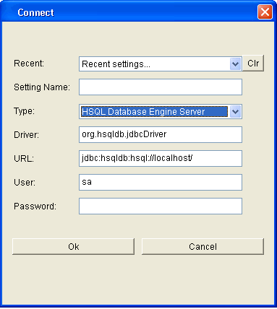
Setting up the Database (2)
The following dialog box pops up. Select the Type as "HSQL Database Engine Server" and click Ok.
The HSQL Databse Manager window opens. Here you can enter the following SQL statement.

Slide 21
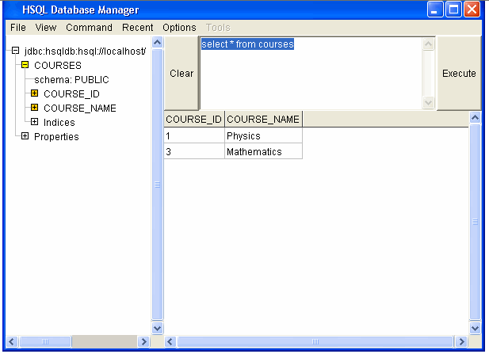
Setting up the Database (3)
To shutdown the HSQLDB properly enter "shutdown" and click the Execute button.

Slide 22
Implementing the Getters (1)
Let’s start with the methods getWidgets() and getWidgetById(Long id). First, we will need to implement a RowMapper to map a row from a ResultSet to a Widget instance. Here is our WidgetRowMapper:
  /**
  * RowMapper for a Widget Record
  */
  public class WidgetRowMapper implements RowMapper
  {
  /**
  * Creates a Widget from a ResultSet
  */
  public Object mapRow(ResultSet rs, int rowNum)
  {
  Widget widget = new Widget();
  try
  {
  widget.setId(new Long(rs.getLong("WIDGET_ID")));
  widget.setName(rs.getString("NAME"));
  widget.setSize(rs.getInt("SIZE"));
  }
  catch (SQLException e)
  {
  }
  return widget;
  }
  }

Slide 23
Implementing the Getters (2)
Spring will deal with creating ResultSets and will pass them to this RowMapper as it iterates over the results; it is just our job to take the current row of the ResultSet and turn it into a Widget object.
getWidgets() method, we can simply use a SELECT statement along with our WidgetRowMapper to call the query method on our internal JdbcTemplate instance
...
public Collection getWidgets()
{
return jdbcTemplate.query("select WIDGET_ID, NAME, SIZE + "
"from WIDGETS",
new WidgetRowMapper());
}
...
}
Notes:
Spring deals with all of the ugly try/catches around Statement/PreparedStatement/Connection creation/clean-up behind the scenes.

Slide 24
Implementing the Getters (3)
Let’s do the method getWidgetById(Long id).
...
public Widget getWidgetById(Long id)
{
String sql = "select WIDGET_ID, NAME, SIZE " +
"from WIDGETS where WIDGET_ID = ?"
return (Widget) jdbcTemplate.queryForObject(sql ,
new Object[] { id },
new WidgetRowMapper());
}
...
We call the queryForObject method on the JdbcTemplate, passing it our SQL
and then our parameters for our SQL query, followed by a WidgetRowMapper.

Slide 25
Implementing the Save (1)
Let’s proceed to the the createWidget(Widget widget) method.
public void createWidget(Widget widget)
{
Object[] params =
new Object[]
{
widget.getName(),
new Integer(widget.getSize()),
};
String query = "INSERT INTO WIDGETS ( NAME, SIZE) VALUES (?,?)";
jdbcTemplate.update(query,params);
}

Slide 26
Implementing the Save (2)
Let’s proceed to the the updateWidget(Widget widget) method.
public void updateWidget(Widget widget)
{
Object[] params =
new Object[]
{
widget.getName(),
new Integer(widget.getSize()),
widget.getId()
};
String query = “update WIDGETS "+
"set NAME = ?, SIZE = ? "+
"where WIDGET_ID = ?
jdbcTemplate.update(query,params);
}
JdbcTemplate’s update method an update SQL statement and then an
Object array to be used as parameters for the update statement
(Spring will internally use a PreparedStatement and set the parameters
appropriately from the Object[]).

Slide 27
Implementing the Delete
Let’s proceed to the the deleteWidget(Widget widget) method.
public void deleteWidget (Long widgetId)
{
Object[] param =
new Object[]
{
widgetId
};
String query = “DELETE FROM WIDGETS "+
"where WIDGET_ID = ?
jdbcTemplate.update(query,param);
}

Slide 28
Implementing the DeleteAll
Let’s proceed to the the deleteAllWidget() method.
public void deleteAllWidgets ()
{
String query = “DELETE FROM WIDGETS”;
jdbcTemplate.update(query);
}

Slide 29
Execution of the Example
public static void main(String[] args) {
ApplicationContext context = new ClassPathXmlApplicationContext("beans.xml");
WidgetService service = (WidgetService) context.getBean(" widgetService ");
service.create(new Widget (1L,“Rich Text Editor",20));
Widget sampleWidget = service .getWidgetById(1L);
}

